Slide 1
Prediction of protein folding class using global description of amino acid sequence
INNA DUBCHAK, ILYA MUCHNIK, STEPHEN R. HOLBROOK,
AND SUNG-HOU KIM
Proc. Natl. Acad. Sci. USA Vol. 92, pp. 8700-8704, September 1995
Presenter : Hsiao-Yen Chang
Data :October 12, 2006

Slide 2
Abstract
We present a method for predicting protein folding
class based on global protein chain description and a
voting process. Selection of the best descriptors was
achieved by a computer-simulated neural network trained
on a data base consisting of 83 folding classes. Protein-
chain descriptors include overall composition, transition,
and distribution of amino acid attributes, such as relative
hydrophobicity, predicted secondary structure, and
predicted solvent exposure.

Slide 3
Abstract
Cross-validation testing was performed on 15 of
the largest classes. The test shows that proteins
were assigned to the correct class (correct positive
prediction) with an average accuracy of 71.7%,
whereas the inverse prediction of proteins as not
belonging to a particular class (correct negative prediction)
was 90-95% accurate. When tested on 254 structures used
in this study, the top two predictions contained the correct
class in 91% of the cases.

Slide 4
Data Base
Our assignment was based on the classification scheme 3D_ALI of Pascarella and Argos (6) that classifies the majority of known 3D structures (254 proteins and protein domains) into 83 classes, 38 of them having two or more members and the other 45 classes containing only a single protein example.
The average sequence identity over all possible aligned Protein Data Bank sequence pairs is 15%.

Slide 5
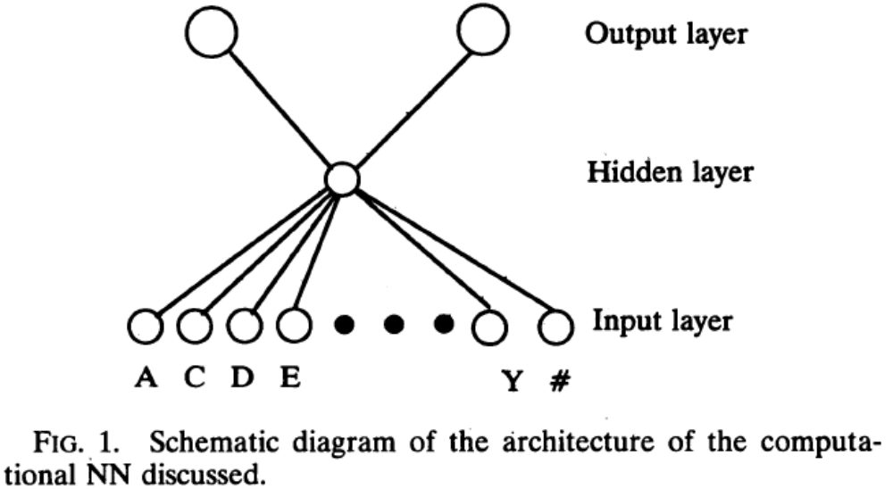
Neural Network
Three-layer feed forward NNs with weights adjusted by conjugate gradient minimization using the computer program BIOPROP (22) were utilized in our study.

Slide 6
Physical and Stereochemical Properties of Amino Acids Used
Hydrophobicity of amino acids.
  Arg, Lys, Glu, Asp, Gln, and Asn as polar.
  Gly, Ala, Ser, Thr, Pro, His, and Tyr as neutral.
  Cys, Val, Leu, Ile, Met, Phe, and Trp as hydrophobic.
Secondary structure.
  helix, strand, and coil.
  helix, strand, coil, and unknown.
Solvent accessibility of amino acids.
  buried or exposed (if >20% of its surface is exposed).

Slide 7
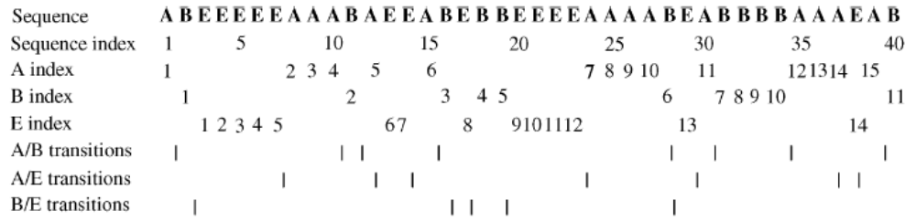
Global Protein Sequence Descriptors
We use three descriptors, composition (C), transition (T), and distribution (D), to describe the global composition of a given amino acid property in a protein.

Slide 8
Combined Protein Sequence Descriptors
Hydrophobicity attribute (HP).
  C:3 T:3 D:15
Secondary structure
  Prediction of Qian and Sejnowski (20) (SS1).
  Prediction of Holley and Karplus (21) (SS2).
    Both of them use a three-state model (helix, strand, and coil).
    C:3 T:3 D:15
  The consensus prediction of the two methods (SS3).
    A four-state model (helix, strand, or coil, and unknown).
    C:4 T:6 D:20
Solvent accessibility (SA).
  C:1 T:1 D:5

Slide 9
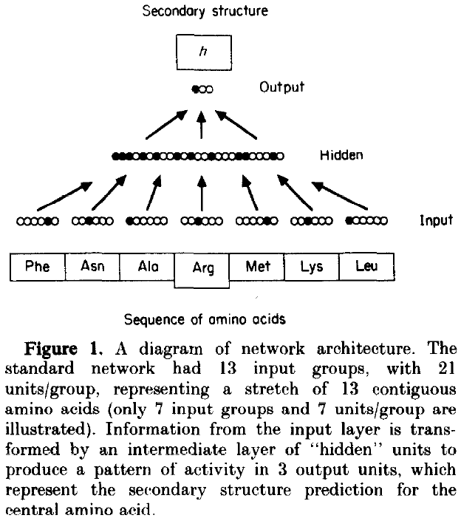
SS1

Slide 10
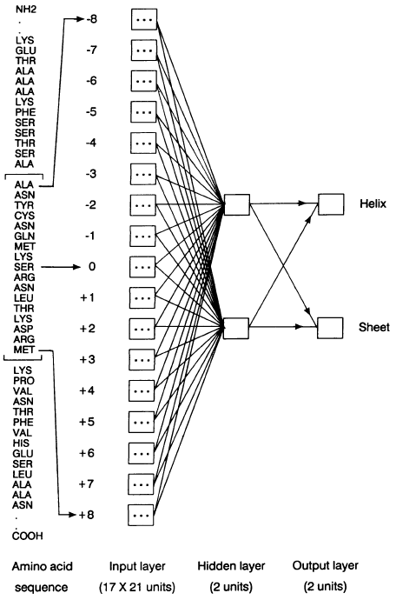
SS2
(1,0) = helix, (0,1) = sheet, and (0,0) = coil.

Slide 11
General Prediction Scheme and Evaluation of Combined Protein Chain Descriptors
For an amino acid sequence, each network gives one of two answers: yes, if its 3D structure corresponds to that class, or no, if it belongs to one of the remaining 82.
The percent of the proteins that pass this criterion for various combined descriptors is as follows: 83.8% for HP, 62.2% for SS1, 58.6% for SS2, 50.8% for SS3, and 25.6% for SA .

Slide 12
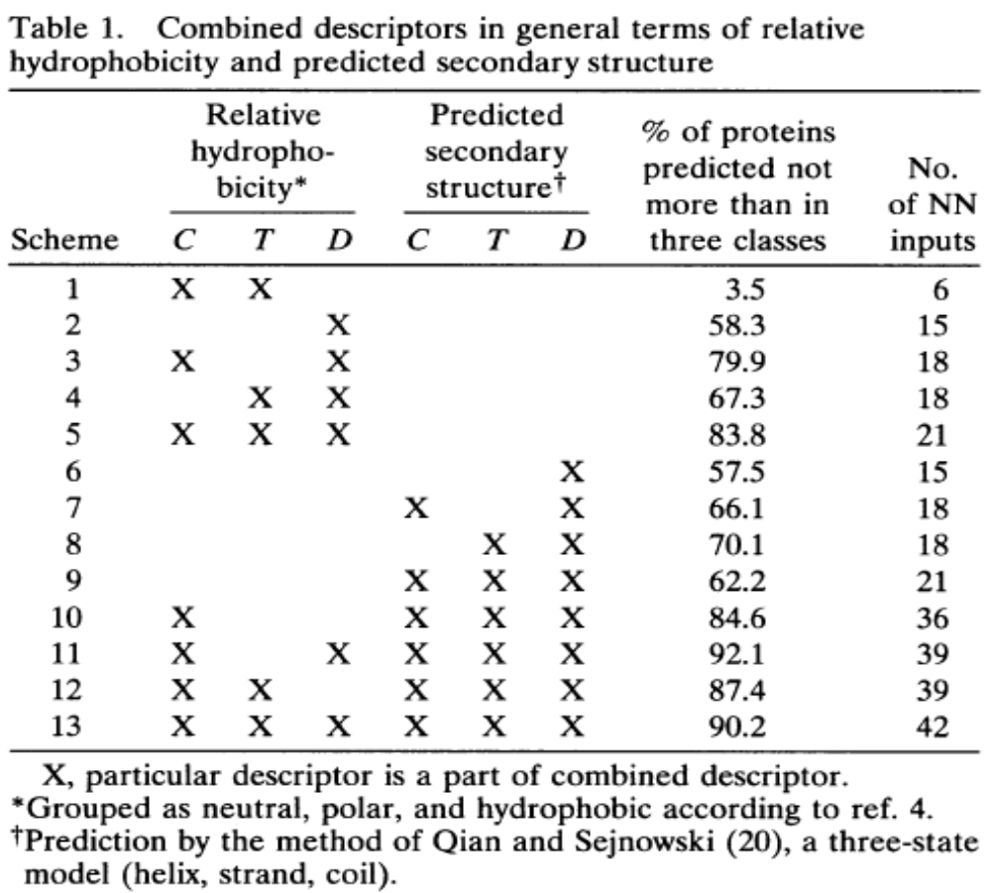

Slide 13
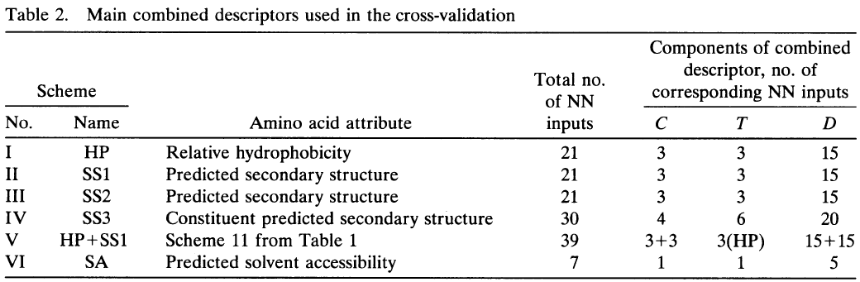
General Prediction Scheme and Evaluation of Combined Protein Chain Descriptors

Slide 14
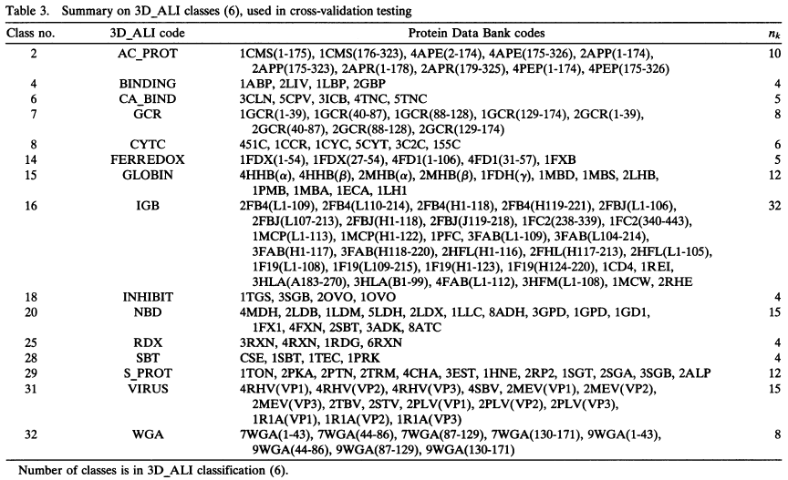
Cross-Validation by Voting

Slide 15
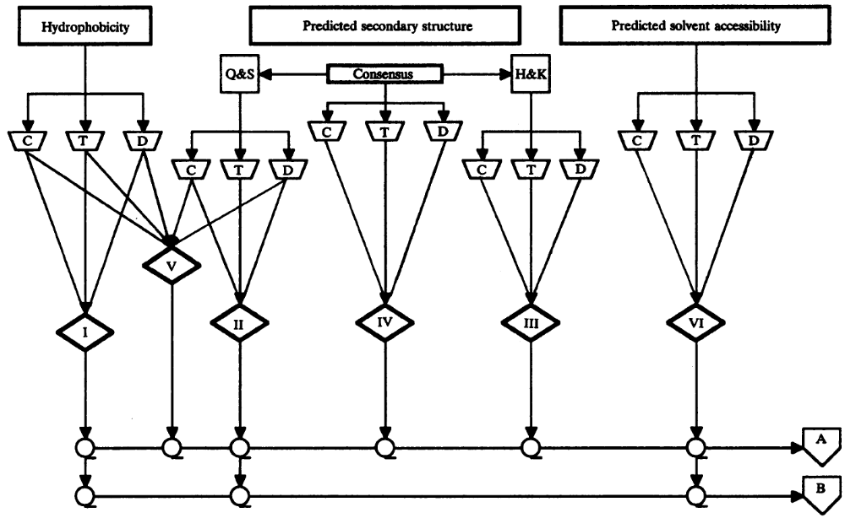
Cross-Validation by Voting

Slide 16
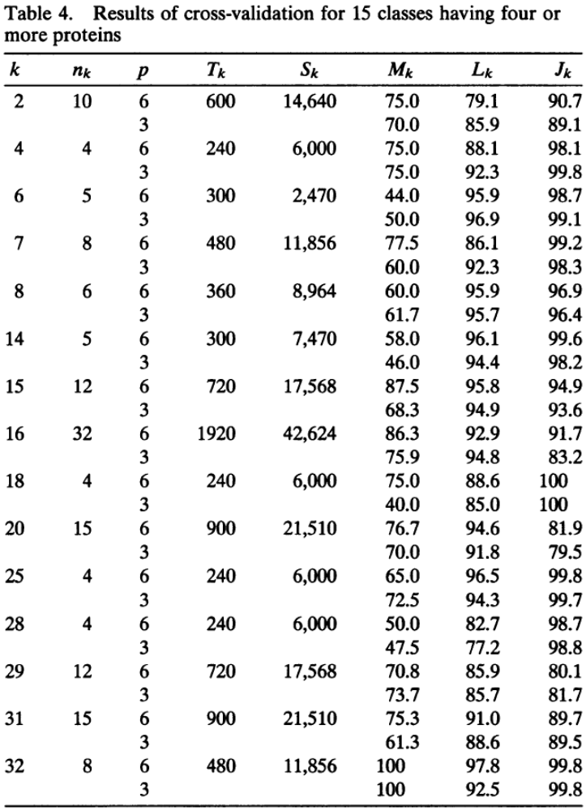
k, Number of class.
n_{k}, number of proteins in class k.
p, number of chain descriptions participated in voting.
T_{k} = p10 n_{k}, the overall number of training/testing sessions for class k proteins.
S_{k} = p(254 - n_{k}) n_{k}, total number of testings of proteins not belonging to k.
M_{k}, percent of the proteins from class k correctly predicted to be in k.
L_{k}, percent of the proteins from other classes correctly assigned to one of those other classes.
J_{k}, percent of class k proteins correctly assigned to the group others being in complement subsets to other 14 classes.

Slide 17
Results and Discussion
The average numbers for M_{k} for A and B are 71.7% and 64.8%, respectively.
The average numbers for L_{k} for A and B are 91.2% and 90.8%, respectively.
The average numbers for J_{k} for A and B are 94.6% and 93.7%, respectively.

Slide 18
Results and Discussion
When tested on 254 structures used as the data base in our study, the top predicted class was correct in 59% of the cases, the top two predictions contained the correct folding class in 91% of the cases, and the top three predictions included the correct class in 97% of the cases.

